Slide 1
CASE PRESENTATION

Slide 2
Patient Particulars
Name: M.A.M
Age: 54 years old
Sex: Female
Residence: Tabata
Education: primary
Occupation: Entrepreneur
DOA:01/07/2026
DOC:01/07/2026
Insurance status: Not Insured
Informant: Patient
Marital status: married
Referral :Tabata Direct Aid hospital

Slide 3
INTRODUCTION
Known hypertension for more than 20 years not on regula medications
Also known with T2DM for 5 yrs currently on germa 2

Slide 4
Chief Complaints
Chest pain for 7 days
Difficult in Breathing for 4 Day

Slide 5
History of presenting illness
Chest pain for 7 days
Gradual onset
progressively worsened over time
central in location
sharp in character
radiated to the back
not associated with radiation to the left arm, shoulder, jaw or neck.
The pain was associated with abdominal fullness
Early satiety
Heartburn nausea
several episodes of non-projectile, non-bilious and non-blood-stained vomiting.
The pain became worse after meals and improved when the stomach was empty.

Slide 6
History of presenting illness
Chest for 7 days
Not associated with
Diarrhoea
Constipation
Melena or hematemesis
Jaundice
Cough
sputum production

Slide 7
History of presenting illness
Difficult in breathing for 4 days
Gradual onset
More on exertion initially while climbing hills, but subsequently even at rest.
associated with difficulty lying flat, air hunger at night, awareness of heartbeat and dizziness

Slide 8
History of presenting illness
Difficult in breathing for 4 days
Not associated with:
Syncope/LOC
Facial/lower limb swelling
Reduced urine output
Urinary symptoms

Slide 9
History of presenting illness
She reported intermittent fever during the illness not associated with chills or rigors
She also reported unintentional weight loss and headache
She had travelled by bus for approximately five hours shortly before referral

Slide 10
History of presenting illness
No history of
Convulsions
Visual disturbances
LOC
Focal neurological deficit
Painful swallowing
Painful urination
Per urethral discharge
Reduced urine output
Passing frothy urine

Slide 11
History of presenting illness
No History of
Bleeding per gums
Vomiting blood
Passing black tarry stool
Passing fresh blood in stool
Blood in urine
Easy skin bruising
Anterior neck swelling
Heat or cold intolerance
Tremors
Anxiety or irritability
Excessive thirst
Excessive sweating

Slide 12
History of presenting illness
No history of
IV drug abuse
TB diagnosis
Cigarette smoking
Hepatitis B vaccination
Multiple sexual partners

Slide 13
Review of the other systems
ENT: No history of nosebleed, no ear pain, no ear discharge

Slide 14
Course of illness
she attended another health facility in Tabata where ECG reportedly showed STEMI and she was referred to JKCI for further management.

Slide 15
Past Medical History
First Admission at JKCI
No history of surgery or BT
No known food or drug allergies

Slide 16
Gynecological history
She is post Menopause
No PV discharge or Bleeding

Slide 17
Family social history
She is married, lives with her husband and daughter
No family history of, similar presentation or any other chronic disease
She used to be drinking beer occasionally
No hx of Cigar ate smoking
No hx of sudden death in the family
Used to work as an Entrepreneur

Slide 18
Dietary History
Three meals per day
Breakfast: tea with bread/chapati
Lunch/ Dinner: stiff porridge/ rice/ with sardines/ meat/beans and vegetables
Water intake: 2L/day
Conclusion: Adequate in quality and quantity

Slide 19
Summary 1
Mrs.M.A.M. is a postmenopausal female with a background history of long-standing hypertension (>20 years) and type 2 diabetes mellitus (5 years), admitted as a referral from Tabata Hospital with a diagnosis of suspected ST-elevation myocardial infarction (STEMI).
Presented with 7 days hx of atypical presentation of angina chest pain associated with dyspeptic symptoms with 3 days hx of symptoms of heart failure
Has positive hx of recent travel for 5hrs and positive hx of alcohol use but no hx of cigarate smoking

Slide 20
General Examination-1
Fully Conscious
No boozing of the skull
Normal hair color and distribution
Pale conjunctiva,
No conjunctival hemorrhage
No malar rash
No angular cheilitis or stomatitis
No mouth dryness
No oral ulceration or thrush
No bleeding gums/lips
No parotid gland enlargement
No nose deformity, no septal perforation

Slide 21
General Examination-2
No Spider naevi
No leukonychia
No koilonychia
No finger clubbing
No nail pitting
No palmar erythema
No Dupuytren contracture
No flapping tremors
No xanthomas
No palpable peripheral lymph node
No Petechiae or ecchymosis
Mild lower limb edema at the level of ankle bilaterally
Conclusion: Pale with bilateral lower limb pitting edema

Slide 22
General Examination-3
Vital signs and anthropometric measurement
BP-124/69mmHg
PR -86b/m
RR -22 breaths/min
SPO2- 94% RA
T-36.8 ° Centigrade
RBG-7.8mmol/L
Weight- 68 Kg
Height- 154 cm
BMI- 28.69Kg/m2
Conclusion: tachypnoea, and Overweight

Slide 23
Cardiovascular Examination
Warm extremities
Pulse rate 86 beats/min
Regular radial pulse, good volume, non collapsing, synchronised with brachial, femoral, popliteal, dorsalis pedis pulses
No raised jugular venous pressure
No precordial hyperactivity
No parasternal or apical heave
No thrill
Apex beat 6th ICS lateral MCL
No pericardial friction rub
S1 and S2 heard, pan systolic murmur at mitral Area radiating to the axillar and loud P2
Conclusion: Cardiomegaly and Mitral Regurgitation and Pulmonary HTN

Slide 24
Respiratory System Examination-1
RR=22 breaths per min
Normal chest contour
No traditional marks or scar
Bilateral symmetrical chest movements
Bilateral symmetrical chest expansion
Trachea is centrally located
No palpable mass

Slide 25
Respiratory Examination -2
No area of tenderness
Normal tactile vocal fremitus,
dull percussion note infrascapular on both lungs more on the right
vesicular breath breath sounds heard bilateral with reduced breath sound on infrascapular in both lung more on the right lung and creaitations
Conclusion:Tachypnoea,features suggestive of pulmonary edema and pleural effusion

Slide 26
Nervous System-1
Higher centres
Conscious
Glasgow Coma Score – 15/15
Oriented to tome, place and person
Normal short- and long-term memory
Coherent speech
Conclusion: Normal higher centre examination

Slide 27
Nervous System-2
Signs of meningeal irritation:
  Neck was soft
  Negative Brudzinski sign
  Negative Kernig’s sign
Conclusion: No sign of meningeal irritation

Slide 28
Nervous System-3
Cranial nerve examination
CN I: Could smell in both nostrils
CN II:
  Pupils normal size, shape, responding to light
  Normal visual fields
  Colour vision normal
  Normal fundoscopy
CN III, IV and VI
  Normal ocular movements

Slide 29
Nervous System-4
Cranial nerve examination:
CN V : Could clench teeth with normal sensation on the face
CN VII: Normal facial expression
CN VIII: Could hear normally on both ears
CN IX : Could swallow normally
CN X: Gag reflex present
CN XI: Can turn neck sideways against resistance
CN XII: No tongue deviation, no atrophy, no fasciculation
Conclusion: Normal cranial nerves findings

Slide 30
Motor System Examination-5
UPPER LIMBS
 | LEFT LIMB | RIGHT LIMB
Fasciculation | None | None
Bulkiness | Normal bulkiness in all muscle groups | Normal bulkiness in all muscle groups
Tone | Normal | Normal
Power | Arm: Flexors, extensors, abductors, adductors 5/5 Forearm: Flexors 5/5, Extensors 5/5 | Arm: Flexors, extensors, abductors, adductors 5/5 Forearm: Flexors 5/5, Extensors 5/5
Reflex | Normal | Normal
Conclusion: Normal

Slide 31
Motor System Examination -6
LOWER LIMBS
 | LEFT LIMB | RIGHT LIMB
Fasciculations | None | None
Bulkiness | Normal | Normal
Tone | Normal | Normal
Power | Thigh: 5/5 Leg: flexors - extensors –5/5 | Thigh: 5/5 Leg: flexors – 5/5
Deep tendon reflex Ankle reflex | Normal | Normal
Plantar reflex | Equivocal | Equivocal
Conclusion: Normal

Slide 32
Anterior Neck Examination
No visible neck swelling
No scars , redness or dilated veins over the anterior neck
Thyroid gland non palpable, no nodules or tenderness, no cervical lymphadenopathy
No bruit heard over the thyroid
Conclusion :Normal anterior neck examination

Slide 33
Abdominal Examination-1
Normal abdominal contour moves with respiration
Umbilicus inverted and centrally located
No visible veins
No surgical scars
No tenderness
Liver span 12cm
Spleen could not be palpated
Kidneys not bimanually palpable
No shifting dullness
Tympanic note
Normal bowel sounds, no renal bruits, no aortic bruits
Conclusion: Normal PAE

Slide 34
Abdominal Examination-2
DRE
Normal anal verge
Normal sphincter tone
Free rectal mucosa
Gloved finger stained with brown coloured stool
Conclusion: normal DRE findings

Slide 35
Summary 2
Mrs. M.A.M. is a postmenopausal female with a background history of long-standing hypertension (>20 years) and type 2 diabetes mellitus (5 years), admitted as a referral from Tabata Hospital with a diagnosis of suspected ST-elevation myocardial infarction (STEMI)
Presented with 7 days hx of atypical presentation of angina chest pain associated with dyspeptic symptoms with 3 days hx of symptoms of heart failure
Has positive hx of recent travel for 5hrs and positive hx of alcohol use but no hx of cigarate smoking
O/E conscious,pale,tachypneac(RR 22),bilateral lower limb edema,cardiomegaly,mitral regurgitation with features of pulmonarary edema and pleural effusion

Slide 36
Diagnostic Formulation

Slide 37
PROBLEM LIST
Acute chest pain syndrome
Acute decompensated heart failure
Pulmonary oedema
Bilateral pleural effusions
Long-standing hypertension
Type 2 diabetes mellitus
Possible acute mitral regurgitation
Possible pulmonary hypertension

Slide 38
Provisional diagnosis
.Acute heart failure sec to ischemic heart disease presented with
pulmonary edema
Bilateral pleural effusion
Differential diagnosis of:
STEMI
Acute Aortic syndrome
Pulmonary embolism
Peptic Ulcer Disease

Slide 39
ST Elevation Myocardial Infarction(STEMI)
Point for:
Angina Chest pain
Features of heartfailure after chest pain
Pulmonary edema
Long standing hypertension
Diabetes
Points against:
Characteristics of chest pain radiation and association of the pain with dyspeptic syndrome
Notes:
This coud either be atypical presentation or there is coexisting underlying GI pathology

Slide 40
Acute Aortic Syndrome
Points for:
Chest pain that radiates to the back
Points against:
Hemodynamics stability
Mo pulse deficit
No neurological defecit

Slide 41
Pulmonary embolism
Points for:
Dyspnea
Recent prolong travel
Points against:
Preceding prolonged chest pain
Pulmonary edema

Slide 42
Peptic ulcer disease
Points for:
Dyspeptic symptoms
Post prandial worsening of the pain
Points against:
Does not explain pukmonary edema

Slide 43
Investigations
IMMEDIATE investigation
ECG & ECHO
Chest x ray
Troponin I
Laboratory investigation
FBP,Renal functions test,liver function tests,electrolytes,HBA1C,lipid profile,coagulation profile,BNP/NT-proBNP,ABG
DEFINITIVE
Coronary angiography

Slide 44
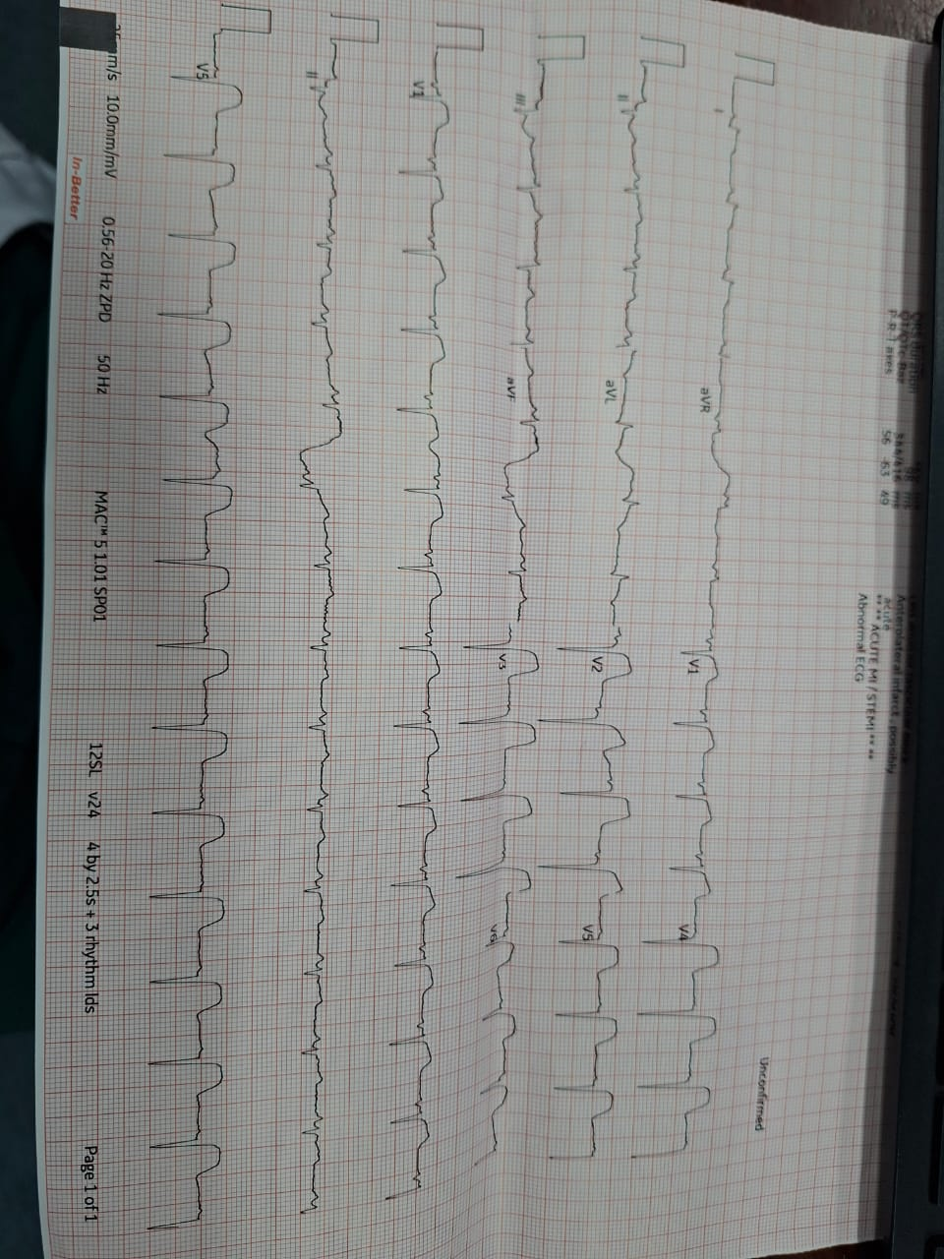
ECG
Notes:
The ECG demonstrates sinus rhythm with marked ST-segment elevation involving leads V2 to V6, I and aVL, associated with loss of R-wave progression and developing pathological Q waves, consistent with an extensive acute anterolateral ST-elevation myocardial infarction. The likely culprit lesion is a proximal left anterior descending artery occlusion."

Slide 45
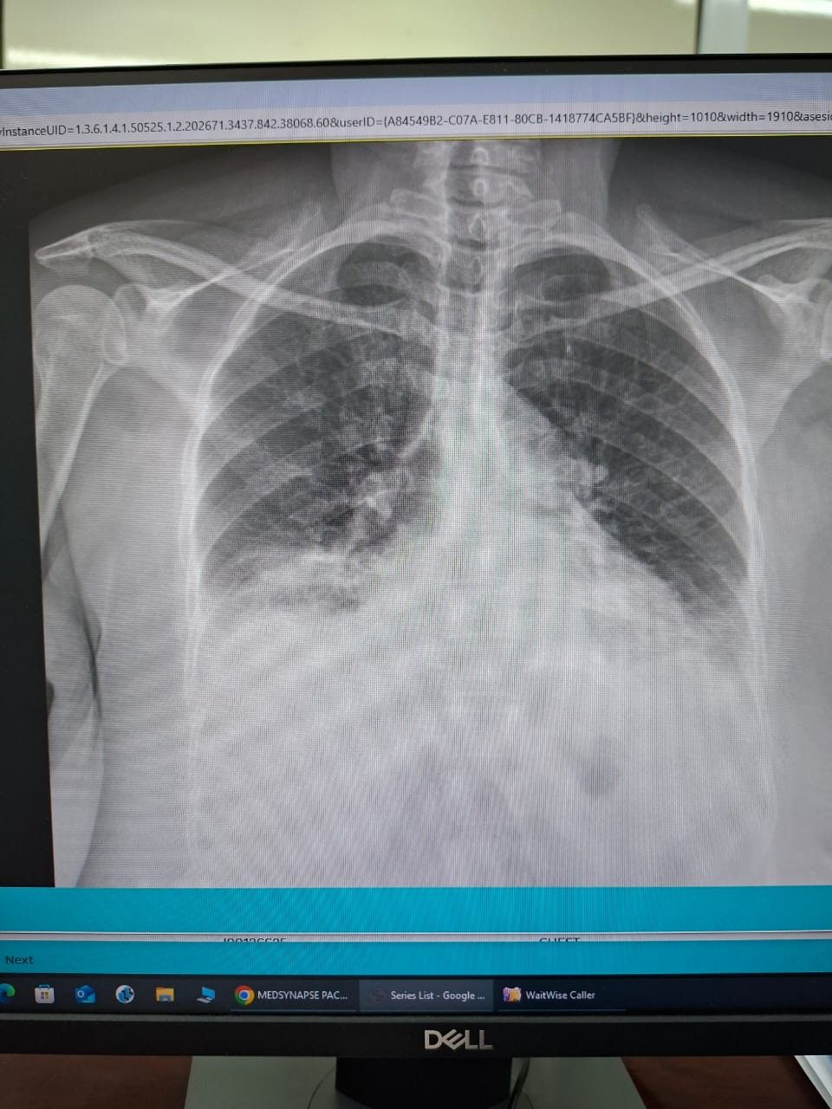
Chest x ray
Notes:
Cardiomegaly, Pulmonary vascular congestion, Pulmonary oedema,Bilateral pleural effusions,
Overall consistent with:
Congestive cardiac failure secondary to extensive acute myocardial infarction.

Slide 46
ECHO
VEF approximately 25–40%.
Anterior wall hypokinesia/akinesia.
Left ventricular apical thrombus
Mild to moderate mitral regurgitation
Pulmonary Hypertension

Slide 47
CAG FINDINGS
100% thrombotic occlusion of proximal LAD
PCI done

Slide 48
Management
Iv furosemide 60mg bd
Inj enoxaparin 40mg bd
T dapagliflozin 10mg OD
T valsartan/sacubiltrin 50mg OD
T eplenorone 25mg OD
T germa 2 OD
T atorvastatin 40mg od

Slide 49
Learning points for discussion
STEMI in diabetic patients frequently presents atypically.
Acute heart failure developing after chest pain strongly suggests extensive myocardial infarction.
A new pan systolic murmur after STEMI should prompt urgent evaluation for papillary muscle dysfunction or rupture causing acute mitral regurgitation.
Echocardiography is essential to assess left ventricular function, identify regional wall motion abnormalities, quantify mitral regurgitation, and detect mechanical complications.
Patients presenting late (>24 hours after symptom onset) still benefit from coronary angiography when there is ongoing ischemia, heart failure, or evidence of viable myocardium.

